Slide 1
Course organization
Lectures: most Mondays and Wednesdays
Stephan Bohacek
Homework 20% (every 2-3 weeks)
Exams (midterm 25% and final 25%)
Labs: most Fridays
Chase Cotton
Assignments 30%
Canvas: https://udel.instructure.com/courses/1498333
UD capture recordings
Upload homework
Web page
Lecture notes (will be continuously updated, but should be ready before class)
Assignments
Textbook
Some homework
Extra reading, but all required material is in the lecture notes

Slide 2
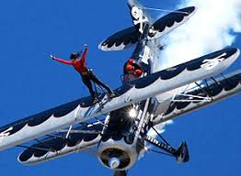

About this course
Analogy
Introduction to cybersecurity
Not introduction to hacking
Wide range of students
Everyone will get bored and not understand at some point
Topics
What is cybersecurity
How to build secure systems
How to work toward secure enterprises
Some details about some attacks and defense
Labs to get hands-on experience with systems and security
vs
~4 Billion passengers/year.
How to make airlines safe?
$
~$3.5 Trillion ecommerce revenue in 2019
How to keep that safe?

Slide 3
Chapter 1: Introduction
Components of computer security
Threats
Policies and mechanisms
The role of trust
Assurance
Operational Issues
Human Issues

Slide 4
CIA
C: Confidentiality
I: Integrity
A: Availability
The goal of security is to preserve CIA
Notes:
Confidentiality: a good example is cryptography, which traditionally is used to protect secret messages. But cryptography is traditionally used to protect data, not resources. Resources are protected by limiting information, for example by using firewalls or address translation mechanisms.
Integrity: a good example here is that of an interrupted database transaction, leaving the database in an inconsistent state (this foreshadows the Clark-Wilson model). Trustworthiness of both data and origin affects integrity, as noted in the book’s example. That integrity is tied to trustworthiness makes it much harder to quantify than confidentiality. Cryptography provides mechanisms for detecting violations of integrity, but not preventing them (e.g., a digital signature can be used to determine if data has changed).
Availability: this is usually defined in terms of “quality of service,” in which authorized users are expected to receive a specific level of service (stated in terms of a metric). Denial of service attacks are attempts to block availability.

Slide 5
Confidentiality
Keeping data and resources hidden
Military
Need to keep attack plans away from the enemy
As a precaution, information is restricted according to the “need to know” principle
Industry
Need to keep product launch or trade secrets away from competitors
Access control supports confidentiality
E.g., a file is encrypted/scrambled to make the data unreadable. A cryptographic key is used to decrypt
Access to the data is controlled by controlling who has access to the cryptographic key
Note, there are other access control mechanisms
Encryption fails to maintain confidentiality when
the key is not confidential
When the data is stolen when unencrypted, e.g., by taking a screen-shot, or simply copying the unencrypted data
Encryption does not hide the existence of the data
E.g., the pentagon was preparing a surprise attack on Iraq. The planning was hidden. However, by watching the food delivery trucks, one could determine that many big late night meetings where occurring.
Other system access controls can hide the existence of data

Slide 6
Confidentiality vs. privacy
Subtle difference (or maybe no difference)
Privacy is related to personal information
Confidentiality is related to data
Personal information is a type of data
802.11i (wifi security)
The first version used the word privacy
A later draft change the word privacy to confidentiality, which the correct usage
Facebook has problems with privacy
Lockheed Martin has problems with confidentiality

Slide 7
Examples of Confidentiality
Your credit card number should be confidential
Access is only provided by merchants as needed
By stealing credit cards, confidentiality is broken… or is it?
A company database can contain confidential technical data.
The database is access through a web interface. And users only have access to part of the database that is relevant to their work.

Slide 8
Integrity
Definitions
The trustworthiness of data or resources
Preventing improper or unauthorized change
Is the data correct or accurate
Data integrity (the data is correct) and origin integrity (the source of the data is correct)
Examples
A newspaper prints a story. The details are correct, but they give the incorrect source; data integrity, but corrupted origin integrity
A payroll system reads the pay rate from a database. If an attacker changes the data in the pay rate database, they can cause incorrect pay checks to be generated.
A communication system encrypts transmissions. E.g., the message “transfer $1000 to account U” is encrypted to ‘1231313’. The attacker does not know this, but does see the message 1231313 being exchanged. At a later time, the attacker sends the message 1231313, and a transfer is performed a second time.
Not confidentiality
When the pentagon plans an attack, the plans are secret.
Learning the plans is a breach of confidentiality
Changing them is a breach of integrity
Sometimes data can be changed without knowledge of the data
Clearly, in some cases we need both, one, or the other
Examples where you need one but not the other
Stolen credit card
Breach of confidentiality or integrity?
In general, passwords are a way to improve integrity (of data or the source, e.g., customer). These techniques transfer the integrity problem (how to determine who is actually making the purchase) to a confidentiality problem (has the credit card number been stolen)

Slide 9
Integrity mechanisms
Prevention mechanisms
Lock the data, e.g., with access controls
Cannot stop authorized access
A program that processes the data is altered
An authorized user changes the data
E.g., access control only allow bank managers to transfer money between accounts.
A bank manager transfer money to his own account
Detection mechanisms
Report that the data is corrupt
E.g., data in a database includes special data that looks normal, but actually obeys rules (e.g., the values sum to 0). If the data is altered, then these data will not obey the rules.
Assumes the attacked does not know the special rules
E.g., compare some data to backups
Actually, the same thing as the previous example, and suffers the same
Basic problem: how can you know that data has been corrupted.
With backup and other techniques, it might be possible to recover from integrity violations
Integrity is not only a security issue, i.e., integrity can be violated by non-malicious means, e.g., hard disk failure can corrupt data
Back-up allows recovery from integrity violations
DR = disaster recovery
(or maybe DR = durability and reliability. Well no. but…)

Slide 10
Review
CIA: why?
Fluency. People talk about CIA all the time. You must understand it perfectly. But it is easy
Confidentiality
Pretty much what you think it is: keeping things secret
Key mechanisms
Encryption
Access control
Controlling who has access to what (e.g., files, or other things)
perhaps things you didn’t already know
Confidentiality of the existence of data
The existing of late night meetings at the pentagon
Accessing particular web sites, …
Encryption converts confidentiality of the data into confidentiality of the key
You probably knew this, but I think it is interesting how we convert one problem to another
Integrity
That the data is what it should be
Data includes things like the source. E.g., the author of an email, the person making the change
Perhaps things you didn’t know
The difference between integrity and confidentiality
Can you have one without the other
By recording and then replaying the same message, I could trick the system into doing the same thing twice. There is no violation of confidentiality, only integrity
I can put an cryptographic signature on a email to prove that I have written the email and guarantee integrity. But the email could be seen any anyone

Slide 11
Availability
Ability to use the information or resource desired
Examples
When AWS cloud services go down, availability suffers
Denial of service attacks
Send bogus requests to a server, so the server is too busy to handle legitimate requests (we will examine this in detail soon)
Send too much data over a link so legitimate data is lost
Credit card is stolen. Bogus purchase is made. Basic fraud detection flags the purchase and disables the card. Now the legitimate user can no longer use the card.
Protection against availability attacks is difficult
How to tell legitimate from attack traffic
People really want to download Jonas Brothers video. Or is it an attack?
SYN cookies
Fast links and servers
But botnets can be very big too
One reason Availability is important
C and I can be solved by turning everything off
But, Availability suffers, so this non-sensical solution does not meet the objectives of cybersecurity

Slide 12
Examples
Credit card numbers are stolen
C? I? or A?
A user has gained root privileges
C? I? or A?
If no data has been changed and the system is available, then only confidentiality (because a root user can (sometimes) have access to any file)
My car
Is broken
Is stolen
Integrity: The key should provide integrity in that only the holder of the key is allowed access to the car

Slide 13
Threats vs vulnerabilities vs exploits
Fluency
A threat is a potential violation of security
Definition: A threat is something we must protect against
Threats cannot be (easily) controlled or eliminated
Examples
Someone could steal all the money from my bank account
Someone could steal my car
If I use mass transit, then I could eliminate this threat.
Someone could break my leg
This threat is outside the scope of cybersecurity
Someone could change the orbit of the moon
This threat is unreasonable. So I will ignore it
Someone could like the color purple
no,. This is not a threat. I don’t need to protect against this
Cyber security threats are threats against
Confidentiality, integrity, and availability
A vulnerability is a way (that is, a bug or mistake) to act on a threat
Vulnerability of someone stealing my car: I leave my unattended car running with the doors open for many hours
As cybersecurity professionals, we seek to stop vulnerabilities
Stopping threats is more complicated but can have significant impacts, e.g., sell my car and take mass transmit to eliminate the threat of someone stealing my car
An exploit is a program (or method) to take advantage of a vulnerability
Security professionals are more interested in vulnerabilities (a bug for which an exploit could be developed) than the exploit that actually takes advantage of the vulnerability
However, some vulnerabilities are hard to fix, and a firewall can scan for particular exploits until the vulnerability can be fixed

Slide 14
Many threat and many classifications of threats
Alter
Types/classes of threats
Disclosure - unauthorized access to information
Deception - acceptance of false data
Disruption - interruption or prevention of correct operation
Usurpation - unauthorized control of some part of a system
Block
Data
Snoop
STRIDE
Snooping
Tampering
Repudiation
Information disclosure
Denial of Service
Elevation of privilege

Slide 15
Threats: Snooping
Fluency
Disclosure is a large class of threats. Snooping is a type of disclosure.
Snooping is passive listening
Examples of vulnerabilities:
Wiretapping
By bending a fiber cable, a bit of light leaks out
Apparently, the US Navy used to dive in the open ocean, get fiber cables, and tap into them.
Since 9/11, they just tap in at the router.
Review:
Threat: Snooping
Vulnerability: bend fiber optic cable causes the single to leak out. In theory, one can make an optical receiver to receive this signal
Exploit: a piece of hardware and software that allows you to fit the fiber cable, bends the cable, decodes the signal, and saves the data to disk

Slide 16
Threats: Snooping
Fluency
Disclosure is a large class of threats. Snooping is a type of disclosure.
Snooping is passive listening
Examples of vulnerabilities:
Wiretapping
By bending a fiber cable, a bit of light leaks out
Apparently, the US Navy used to dive in the open ocean, get fiber cables, and tap into them.
Since 9/11, they just tap in at the router.
Receiving data on open wifi networks
All machines will receive data sent by any other machine on the wifi network.
Other snooping vulnerabilities you didn’t think about
Key logging
Packet sniffing
Screen recording
RF monitoring
Telescopes
Apple does not allow windows on the first floor
Packet delay (next slide)

Slide 17
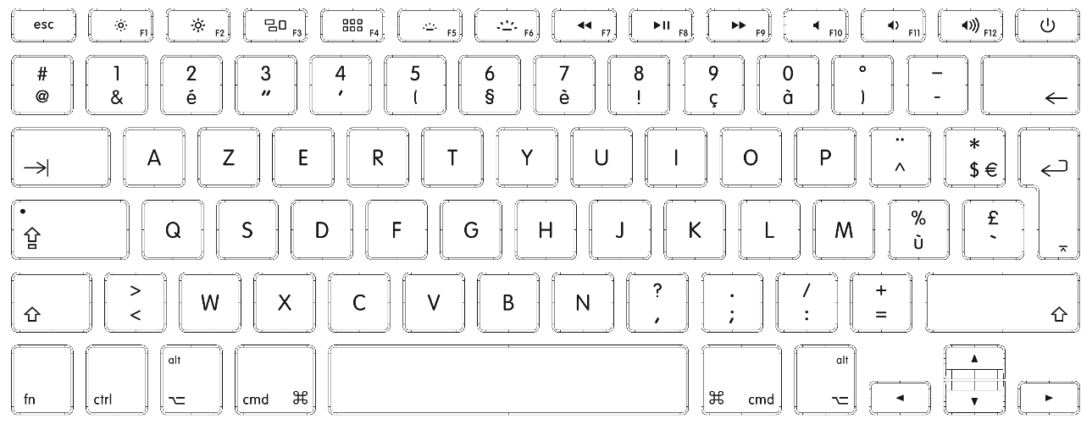
Packet delay
Far keys (pressed after delay)
Near keys (pressed quickly)
Far keys (pressed after delay)
h
i
s
Sp
P
o
p
Sp
b
y
time
Observation: the gap between key presses gives some indication of what key was pressed

Slide 18
Threats: Snooping
Fluency
Disclosure is a large class of threats. Snooping is a type of disclosure.
Snooping is passive listening
Examples of vulnerabilities:
Wiretapping
By bending a fiber cable, a bit of light leaks out
Apparently, the US Navy used to dive in the open ocean, get fiber cables, and tap into them.
Since 9/11, they just tap in at the router.
Receiving data on open wifi networks
All machines will receive data sent by any other machine on the wifi network.
Other snooping vulnerabilities you didn’t think about
Key logging
Packet sniffing
Screen recording
RF monitoring
Telescopes
Apple does not allow windows on the first floor
Packet delay (next slide)
Confidentiality services counter this threat.

Slide 19
Threats: Modification or alteration
An unauthorized change of information
Different classes
Disruption
If password files are changed, then no one can use the machine
Deception
the modified data is used to determine which action to take
E.g., an ATM pin is changed to allow someone else to withdraw money
Man-in-the-middle attack
Messages that are intended to go from sender to receiver, actually go to sender to attacker. Attacker modifies the message, and sends it to the receiver
These attacks are possible on Ethernet
Integrity services protect against these threats
E.g., Access control, message signature
Notes:
Stopped here (I think)

Slide 20
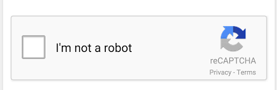
Threats: Masquerading or spoofing
An impersonation of one entity by another
Both deception and usurpation
Examples
An attacker buys something with a stolen credit card. She uses the credit card number to masquerade as the owner of the card
A user tries to log into the web site of their bank. However, the attacker is able to make them log into a different machine instead
DNS attacks can accomplish this
An attacker sends messages to a machine, but has changed the source address of the messages
IP header: destination address, source address, other stuff
An attacker signs up for a free service a billion times, each time acting as a different user
Captcha
Integrity services can protect against this

Slide 21
Threats: Masquerading or spoofing (cont.)
Masquerading might be allowed
Delegation
when one entity authorizes a second entity to perform functions on its behalf
If Susan delegates to Thomas the authority to act on her behalf, she is giving permission for him to perform specific actions as though she were performing them herself
Delegation vs. masquerading
All parties are aware of delegation
Thomas does not claim to be susan
Delegation is very useful
Tight controls against masquerading can limit the ability to masquerade. Limiting the usefulness of the system

Slide 22
Design Example: Defense against Masquerading
Energy usage monitoring and planning
Our company collects data from home appliances to understand energy usage and plan charging or home/car/community battery
What happens if someone sets up a billion appliances?
Each customer gets a password and can only register 12 appliances
When registering an appliance, the user uses captcha
Can an attacker send fake data that looks like an appliance?
When registering an appliance, the appliance gets a secret key. Every data upload must include this secret key.
Can an attacker get a secret key and send data very fast?
We must rate limit how fast each appliance can send data and block violators.

Slide 23
Threats: Repudiation of origin
A false denial that an entity sent (or created) something
A form of deception
Example
A suppose a customer sends a letter to a vendor agreeing to pay a large amount of money for a product.
The vendor ships the product and then demands payment.
The customer denies having ordered the product and by law is therefore entitled to keep the unsolicited shipment without payment.
Integrity mechanisms cope with this threat
Notes:
Stopped here after 50 minutes

Slide 24
Threats: Denial of receipt
A false denial that an entity received some information or message
another form of deception
Example
a customer orders an expensive product,
the vendor demands payment before shipment.
The customer pays, and the vendor ships the product
The customer receives the product
The customer then asks the vendor when he will receive the product
The vendor must prove that the customer actually received the product
Integrity protects against this kind of attack

Slide 25
Threats: delay
A temporary inhibition of a service
Example
By generating interference, packets are lost on a wireless link. Consequently, files can only be downloaded very slowly
By sending fake requests to a web server, the web server will respond to legitimate request more slowly
Web user experience is impacted the speed of web server response
Slower response has been measured to reduce the number of pages visited during a session and the conversion rate
Availability services defend against these types of attacks

Slide 26
Threats: denial of service (DoS) attacks availability
a long-term inhibition of service
An extreme form of delay
A type of usurpation
The attacker is control who does and does not get service
Availability mechanisms counter this threat
History
Early attacks (late 1990’s) where DoS
But there is little motivation to perform DoS, so stealing credit cards and other types of attacks became more popular
Recent DoS
Anonymous
Iran against US banks
Linode (cloud)
Limited defenses against sophisticated DoS
Unsophisticated DoS can be stopped with pattern matching
Some network device detects the pattern of attack packets and drops them. This can happen deep within the network (within an ISP)
If the packets do not match a pattern and cannot be distinguished from legitimate packets, then the attack can only be mitigated with large resources
Heavy traffic can cause DoS and delay.
The impact is the same regardless of whether an attacker is maliciously causing the problem
So it does not matter why the problem occurs
CloudFlare is a company that provides protection against large-scale DDoS

Slide 27
DoS Attack Basics
pkt
attacker
victim
Unknown message is ignored
Specific message requires some processing
Specific message crashes the machine
E.g., SQL Slammer, but these are very rare

Slide 28
DoS Attack Basics
pkt
attacker
victim
Unknown message is ignored
Specific message requires some processing
Specific message crashes the machine
E.g., SQL Slammer, but these are very rare
Unknown message: pros and cons
Specific messages that requires processing: pros and cons
Notes:
e.g., ICMP ping and web request
Unknown messages have little impact on the victim
Unknown messages are no restrictions
Specific messages can have a big impact on the victim
Specific messages require knowning something about the victim and perhaps the victim could fix that problem

Slide 29
DoS Attack Basics
pkt
attacker
victim
Unknown message is ignored
Specific message requires some processing
Specific message crashes the machine
E.g., SQL Slammer, but these are very rare
Unknown message: pros and cons
Specific messages that requires processing: pros and cons
Notes:
e.g., ICMP ping and web request
Unknown messages have little impact on the victim
Unknown messages are no restrictions
Specific messages can have a big impact on the victim
Specific messages require knowning something about the victim and perhaps the victim could fix that problem

Slide 30
DoS Bandwidth attacks
pkt
The victim can block the attacker
A single attacker cannot send that much data
The attacker might be identified
attacker
victim

Slide 31
DoS Bandwidth attacks
pkt
The victim can block the attacker
A single attacker cannot send that much data
The attacker might be identified
attacker
victim
For details, see slides about TCP and UDP
Pkt
Destination Address: 78.23.45.66
Source Address: 128.4.35.9
Google.com
78.23.45.66
Laptop
128.4.35.9
Pkt
Destination Address: 128.4.35.9
Source Address: 78.23.45.66

Slide 32
Spoofed Source Address
Pkt
Destination Address: 78.23.45.66
Source Address: 128.4.35.9
Google.com
78.23.45.66
Laptop
128.4.35.9
Pkt
Destination Address: 128.4.35.9
Source Address: 78.23.45.66
The laptop set the source address to some other address besides its address
Pkt
Destination Address: 78.23.45.66
Source Address: 1.2.3.4
Google.com
78.23.45.66
Laptop
128.4.35.9
Pkt
Destination Address: 1.2.3.4
Source Address: 78.23.45.66
When google.com sends the reply, the packet is sent somewhere else, not back to the laptop

Slide 33

Spoofed Source Address
Block pkts from 128.4.35.9
Pkt
Destination Address: 78.23.45.66
Source Address: 128.4.35.9
victim
78.23.45.66
Attacker
128.4.35.9
The Attacker set the source address to some other address besides its address
Cannot block all IP addresses
Destination Address: 78.23.45.66
Source Address: 1.2.3.4
Attacker
128.4.35.9
victim
78.23.45.66
Destination Address: 78.23.45.66
Source Address: 3.4.5.6
Destination Address: 78.23.45.66
Source Address: 5.6.7.8
But 2-way communication is not possible
e.g., any attack that uses TCP (e.g., HTTP) is not possible

Slide 34
DoS Bandwidth attacks
pkt
The victim can block the attacker
A single attacker cannot send that much data
The attacker might be identified
attacker
victim
botnet
Attacker
slave
commands
Attacker
slave
victim
Attacker
master
Attacker
slave
Higher bandwidth is possible
But the bandwidth is still limited by the size of the botnet
Large botnets get detected and are expensive
Attacker
slave

Slide 35
DNS Amplification Attack
DNS query “from” victim (spoofed return address)
botnet
DNS Server
Attacker
slave
DNS Server
commands
Attacker
slave
victim
Attacker
master
Attacker
slave
Attacker
slave
DNS Server
The DNS servers amplify the bandwidth
1Mbps input results in XMbps output, which is sent to the victim

Slide 36
DNS Amplification
Amplification
A small data rate from the attacker computer causes a significant problem for victim
E.g., bandwidth attack
The attacker is able to send attack traffic at a relatively low rate and cause a significant use of the victim’s bandwidth
DNS amplification attack
DNS
used to translate names to IP address
E.g., www.udel.edu to the IP address of udel’s web server
DNS servers are available to answer DNS queries (e.g., translation questions)
E.g.
linux>> dig www.udel.edu
Asks the local dns machine for the ip address for www.udel.edu
Note that the answer is long. How long?
Linux>> dig www.udel.edu > file.txt
Linux>> ls –l file.txt
The dns request was about 20 bytes and the response is 1042 bytes. This is a factor of ~50 increase
Other options give a factor of 70 increase

Slide 37
Spoofed Source Address Pros and Cons
HTTP uses TCP, which requires 2-way communication
Any attacking using HTTP cannot use spoofed source address
HTTP DDoS attacks
Look at HTTP request on the next slide

Slide 38
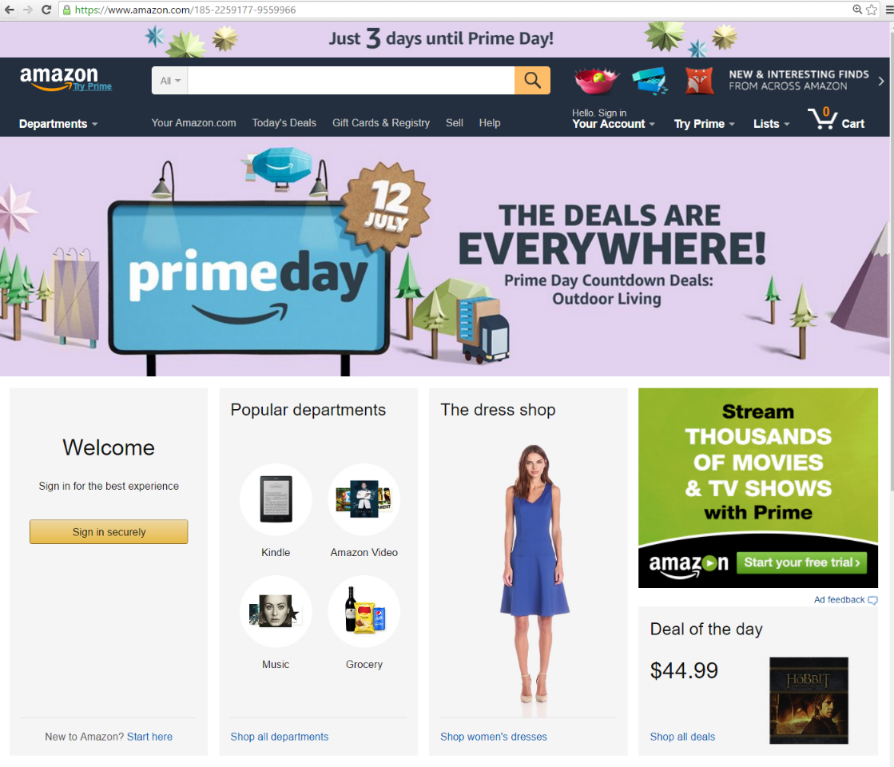
Anatomy of a Web Page
JavaScript search bar
Base HTML file specifies
Text
Layout (e.g., spacing, font)
Objects
JavaScript
Objects (each is a separate file)
Images
Music
Video
JavaScript
Since the base HTML files specifies the objects, it must be downloaded first
The base HTML file and the objects are identified by a URL
A URL has three parts
Protocol (e.g., HTTP)
Web server name
File Name
Layout
Text
JavaScript button
Images
JavaScript video
protocol
URL:
https://www.eecis.udel.edu/~bohacek/Networking/HomeworkAnswers.html
web server
file

Slide 39
Spoofed Source Address Pros and Cons
Can use spoofed source address
Bandwidth attacks with DNS reflector or something that does not use TCP or any 2-way communication
Cannot use spoofed source address
HTTP uses TCP, which requires 2-way communication
Any attacking using HTTP cannot use spoofed source address
HTTP DDoS attacks
Many request for the same object (e.g., pic)
Many request of nonexistent objects (i.e., in valid URL)
Many request for a base-page

Slide 40
DDoS Protection
CloudFlare is a company that provides protection from DDoS (among other things)
AWS, Azure, GCP also provide DDoS protection
Assumptions: Cloudflare has a huge infrastructure. No attacker will bring down cloudflare. Cloudflare does not change extra per attack or for the size of an attack
So what is the attacker trying to accomplish? They cannot attack you and will not impact of Cloudflare

Slide 41



CloudFlare
Without CloudFlare: Users directly connect to your servers
With CloudFlare: Users directly connect to CloudFlare servers. CloudFlare forwards request to your severs as needed and blocks attack traffic

Slide 42



Bandwidth attack protection
Cloudflare has many servers. Your customers’ requests will go to whichever cloudflare server is closest to them.
The attack is spread across many links, even if you only have one server. In any case, cloudflare is very big, so the attacker will not saturate their links or servers
Cloudflare does not forward any attack data to your servers. They only forward http requests
What attacks does this protect against?
Bandwidth attacks with DNS reflector etc.?
Many request for the same object (e.g., pic)
Many request of nonexistent objects (i.e., in valid URL)
Many request for a base-page

Slide 43
DDoS Protection
Protection against repeated http requests
Cloudflare’s Content distribution network (CDN)
Cloudflare buffers replies to web requests.
If attackers repeatedly request the same object, that object is sent to your servers only once. Cloudflare’s CDN will reply to the attackers’ requests
What attacks does this protect against?
Bandwidth attacks with DNS reflector etc.?
Many request for the same object (e.g., pic)
Many request of nonexistent objects (i.e., in valid URL)
Many request for a base-page

Slide 44
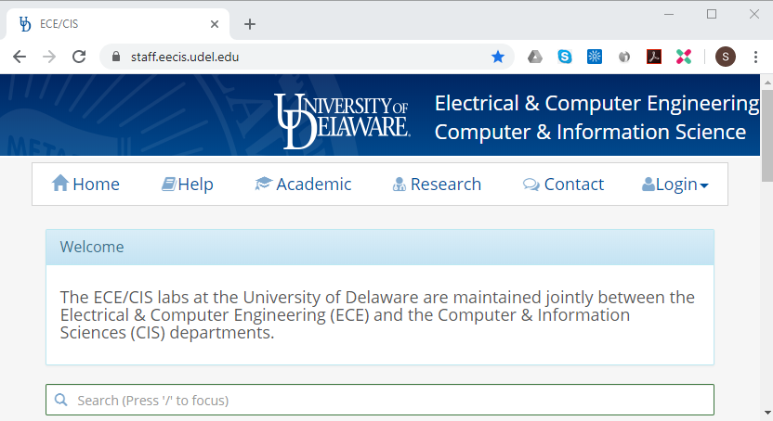
DDoS Protection
Other HTTP attacks
Some attacks will still reach your servers (e.g., if attacker request different objects)
Cloudflare can enable a defense that cause a user validation web page to appear before users can access your page.
This page performs some checks with the browser, records the user IP etc, and then forwards the request.
In this way, they can distinguish between real and attack traffic and only forward real traffic to your servers
This page loads first, and is served by CloudFlare
If the request looks ok, CloudFlare forwards the request to your servers, and they respond in the normal way
What attacks does this protect against?
Bandwidth attacks with DNS reflector etc.?
Many request for the same object (e.g., pic)
Many request of nonexistent objects (i.e., in valid URL)
Many request for a base-page

Slide 45
Vulnerability: Command Injection
Many vulnerabilities that your team will create are of the type Command injection. So let’s take a quick look
If you use c/c++, then buffer overflow can be a bigger problem
Command injection: A vulnerability that allows an attacker to execute instructions in your system
Examples
Moving user uploaded files
SQL Injection
Cross-site scripting
In all cases: a string is being misinterpreted as an instruction. You need to be sure that sure misinterpretation is never possible.

Slide 46
Command Injection: Moving User Uploaded Files
Scenario: The user uploads pictures. Older pictures are moved to an archive system
Details: The picture is moved with the following command
mv FILENAME /archive/FILENAME
Command line
os.system(“mv “+filename+” /archive/”+filename)
Python
Vulnerability: filename = “/var/log /var/log; rm *.*”
Result:
/var/log is copied (doesn’t matter here)
“;” separates two commands, the mv from the next one
“rm *.*” deletes everything. But this command can be anything, like move all other users’ pictures to my folder
Underlying problem: a string of text that the user can control is being interpreted as a command
Who is the programmer? You or the user?

Slide 47
Command Injection
When moving, copying, deleting files, use the language commands
don’t use os.system(“mv “+filename+” /archive/”+filename)
Use: os.rename(filename, /archive/”+filename)
Use better versions of os.system() that allow you to specify the command arguments
Consider: mv filename destFileName
One command and 2 arguments
subprocess.Popen(command, args)
Or even
Instead of os. system(user_command)
If user_command == “run this”:
os.system(“run this”)
elif user_command == “run that”:
os.system(“run that”)
Else:
raise (“unknown command”)

Slide 48
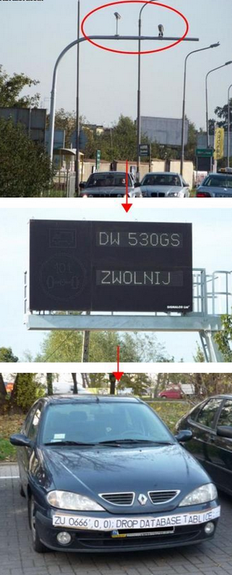
SQL Injection
In a successful SQL injection attack, the attacker is able to execute a SQL query that circumvents protections
http://xkcd.com/327/
Insert into students (name) values (‘bobby’, ‘sam’, ‘steve’, ‘robert’);
drop table students;--);

Slide 49
SQL Injection “Student: ‘wow Stephan, you saved my life’”
Attack: execute some specific code in the database system
Datebases execute queries
Attack: execute some query in the database
E.g. queries
SELECT count(*) FROM student_list WHERE class_name = ‘Cybersecurity’
INSERT student_list(student, class_name) VALUES (‘Stephan’, ‘Cybersecurity’)
DELETE FROM student_list WHERE student = ‘Stephan’
….
DROP TABLE student_list
-- is a comment
SELECT count(*) FROM student_list -- getting the number of students

Slide 50
SQL Injection
Recall queries
INSERT student_list(class_name, student) VALUES (‘Cybersecurity’, ‘Stephan’)
DELETE FROM student_list WHERE student = ‘Stephan’
System:
Enter student name: ?
Get user name, variable userName and add to DB
INSERT (class_name, student) VALUES (‘Cybersecurity’, username)
string = “INSERT (class_name, student) VALUES (‘Cybersecurity’, ‘” + username + “’)”
DB.execute(string)
User-case (no attack)
User enters:
Stephan
string = “INSERT (class_name, student) VALUES (‘Cybersecurity’,’” + “Stephan+ “’)”
String = INSERT (class_name, student) VALUES (‘Cybersecurity’, ‘Stephan’);

Slide 51
SQL Injection
Recall queries
INSERT student_list(class_name, student) VALUES (‘Cybersecurity’, ‘Stephan)
DELETE FROM student_list WHERE student = ‘Stephan’
My low quality app:
Enter student name: ?
Get user name, variable userName and add to DB
INSERT (class_name, student) VALUES (‘Cybersecurity’, username)
Code
string = “INSERT (class_name, student) VALUES (‘Cybersecurity’, ‘” + username + “’)”
DB.execute(string)
Normal case
User enters:
Stephan
Hence, Username = “Stephan”
code
string = “INSERT (class_name, student) VALUES (‘Cybersecurity’, ‘” + username + “’)”
Executed code
string = “INSERT (class_name, student) VALUES (‘Cybersecurity’,’” + “Stephan”+ “’)”
string = INSERT (class_name, student) VALUES (‘Cybersecurity’, ‘Stephan’);
DB.execute(string)

Slide 52
SQL Injection
Recall queries
INSERT student_list(class_name, student) VALUES (‘Cybersecurity’, ‘Stephan)
DELETE FROM student_list WHERE student = ‘Stephan’
My low quality app:
Enter student name: ?
Get user name, variable userName and add to DB
INSERT (class_name, student) VALUES (‘Cybersecurity’, username)
Code
string = “INSERT (class_name, student) VALUES (‘Cybersecurity’, ‘” + username + “’)”
DB.execute(string)
Aattack
User enters:
Stephan’); DROP TABLE students; --
code
string = “INSERT (class_name, student) VALUES (‘Cybersecurity’,’” + “Stephan’); DROP TABLE students; --” + “’)”
string = INSERT (class_name, student) VALUES (‘Cybersecurity’, ‘Stephan’); DROP TABLE students; --’)
This string has 2 sql commands

Slide 53
SQL Injection
System:
Enter student name: ?
Get user name, variable userName and add to DB
INSERT (class_name, student) VALUES (‘Cybersecurity’, username)
string = “INSERT (class_name, student) VALUES (‘Cybersecurity’, ‘” + username + “’)”
DB.execute(string)
Problem:
The user enters username. We have no control over what they input
Then we execute that.
The user control what is executed.
The user directly controls the query, or the code, that is executed
Oh no
Solution: Parameterized queries. Every language has this capability
query = “INSERT (class_name, student) VALUES (‘Cybersecurity’, ? )”
queryData = username
DB.execute(query,queryData)
Key idea: the query and query data are separate
The DB knows that the data is data and no to be executed

Slide 54

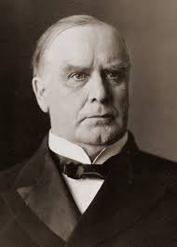
SQL Injection
Solution: Parameterized queries. Every language has this capability
Never allow queries to be built via +
Query = “SELECT user_name FROM students WHERE name = “ + user_name
But Stephan!?!
Id = 17
Query = “SELECT user_name FROM students WHERE app_id = “ + id
Where id is a number generated from code. How could it ever be a sql injection?
Explain why your sql command is actually ok to this guy
Some of my best friends are software auditors, but…
The goal of an audit is to?
Get more business for the auditors. They want to show how smart they are in finding problems.
You and your boss’s boss’s boss get to see the results of the audit.
When the auditor make a mistake, … maybe you can explain it to your boss’s boss’s boss

Slide 55
Goals of Security prevention, detection, recovery
prevention: that an attack will fail or have a limited impact
Examples
An internet-based attack will fail if the machine is not attached to the internet
Passwords: prevent unauthorized users from gaining access to the machine
More specifically, they prevent users without passwords from gaining access to the machine
Checking a downloaded file for viruses
Prevention can be cumbersome
Skype is not allowed
USB sticks are not allowed. So USB ports are plugged
Clearly, prevention is the best approach and is where you will spend most of your effort

Slide 56
Goals of Security prevention, detection, recovery
Some attacks cannot be prevented
Preventative measures are not completely effective
Prevention is based on assumptions, which can be incorrect
Detection can be broad
A program is attempting to do something that is not allowed.
A machine is acting like a server, when it is not configured to be a server
We don’t know how the attack was successful, but we know that is was successful
Detection schemes can allow soft detection
If the behavior seems suspicious, then the detection system can raise an alert of a possible attack
If a user types the wrong password more than 3 times. An alert is raised. But the user is still allowed to try to log on
However, this approach does not work well. The system admin get overwhelmed with alerts. The detector must make a decision
Detection seems fun/cool. But your money should be spent on prevention, which is boring

Slide 57
Goals of Security prevention, detection, recovery
Two forms
Stop an attack
Repair any damage
Repair
If the attacker deleted a file, then the damage is repaired by reloading from back-up
Full repair might not be possible
Fault tolerant systems can run even when some parts of the system have failed
E.g., a distributed and redundant file system can survive even as many machines have been attacked and files deleted
On Amazon’s cloud storage, the probability that a file is not accessible is 10⁻⁸ (it is more likely that a comet will hit the earth)
Fault tolerance is measured in “nines”, the percentage of uptime is 99.99% (4 nines)
Many people praise recovery (DevOps)
Failures happen
The speed at which you recover is critical
A small start-up is trying to beat Amazon at selling diapers. The start-up suffers a problem and is offline. This results in lost business during the outage, but also lost reputation and lost of long-term customers

Slide 58
Policy
Definition. A security policy is a statement of what is, and what is not, allowed.
policies often require some procedural mechanisms that technology cannot enforce
Policy: may be expressed in
natural language, which is usually imprecise but easy to understand;
rarely,
mathematics, which is usually precise but hard to understand;
policy languages, which look like some form of programming language and try to balance precision with ease of understanding
Definition. A security mechanism is a method, tool, or procedure for enforcing a security policy.
Can be technical (access control matrix) or nontechnical, such as requiring proof of identity before changing a password
procedural, in which controls outside the system enforce the policy; for example, firing someone for plugging in usb device obtained from an untrusted source
Example
A university has a policy that students cannot copy homework
The university computer system has mechanisms to enforce this policy
It allows files to be encrypted and placed in non-shared directories
Ann does not take advantage of the mechanisms and leaves her homework on a share drive
Bill copies her homework, which is against the schools policy
In this case, sufficient mechanisms were in place. The problem was that Ann did not use them.
In other cases, the mechanisms might not be sufficient
Notes:
Policy: may be expressed in
natural language, which is usually imprecise but easy to understand;
mathematics, which is usually precise but hard to understand;
policy languages, which look like some form of programming language and try to balance precision with ease of understanding
Mechanisms: may be
technical, in which controls in the computer enforce the policy; for example, the requirement that a user supply a password to authenticate herself before using the computer
procedural, in which controls outside the system enforce the policy; for example, firing someone for ringing in a disk containing a game program obtained from an untrusted source
The composition problem requires checking for inconsistencies among policies. If, for example, one policy allows students and faculty access to all data, and the other allows only faculty access to all the data, then they must be resolved (e.g., partition the data so that students and faculty can access some data, and only faculty access the other data).

Slide 59
Policy Math
Policy can be represented mathematically
Then things can be proved
Maybe
E.g., the policy can be a list of allowed and disallowed states
Often, policy is not precise.
It is often specified in regular English
This can be imprecise
E.g., the policy is that a student cannot copy homework. But can the student see another students homework? Can they paraphrase someone’s homework?
Policy can be in conflict
When two organizations “talk,” they might have different policy
When information is sent from organization A to organization B, the behavior in organization B might be a policy violation if it was to occur inside A
We will study policy in depth

Slide 60
See slides on policy

Slide 61


Policy Vulnerabilities
Great book
Laziness
Poorly written policy
Assholes and bullies
You will work with unfriendly people (employees, colleagues and bosses)
You can completely screw-up by accommodating to their demands rather than following policy
This requires
Always follow policy
Which requires good policy
Recognizing assholes and bullies
Another great book: “How to win friends and influence people”

Slide 62
Security policy and mechanism
Security policy
Defines what is and is not allowed
Can be vague, self-contradictory, or mathematical and complicated
Because of assumptions, the policy might not divide the set of all states into secure and insecurity
E.g., only authorized users can log on to the system
Not enforceable
E.g., only users with password can access the system
Does not divide the system into secure and insecure states
Security mechanism
Implements the security policy
Might not be able to enforce policy
A mechanism is prescription of what to do
Could be steps or rules
Technical security mechanism is a piece of software or hardware that enforces policy
E.g., software that checks that passwords obey rules such as the length, types of characters, etc.

Slide 63
Select all of the following that are security mechanisms for the policy: Only authorized users may log into main computing system.
The main computing system must have a password changing system will reject passwords that are shorter than 8 letters or found in the dictionary.
mechanism
Giving your password to someone else will result in immediate termination.
mechanism
Employees should not hack into the main computing system
Not a mechanism
When customer data is stored on any type of permanent storage such as a hard drive, it must be encrypted using AES with 256 bit keys
Mechanism, but not related to this policy
Customer data that resides on the main computing system must be kept confidential to all employees except the customer-care representative that is actively working on the customer’s case.
Could be policy or mechanism, but not related to this policy
Note that policy and mechanism can look similar
Customer-care representative can only access the main computing system with a key-card, which is returned to the security officer at the end of the work day.
mechanism
A pop-up dialog box that appears when access is granted that says “You are accessing the Main Computing System. Only authorized user may access the Main Computing System. Would you like to proceed? Yes. No”
Mechanism

Slide 64
Assumptions and Trust
Assumptions are a large and fascinating security problem
Examples
Policy: A key is required to open a door. The assumption is that without the key, you cannot get inside. Underlying this assumption is that
There is no backdoor
Lock pickers cannot open the door without the lock
The key is secure
Password
Assumption, if you do not give you password to someone, then your account is safe
Underlying assumption are
There are no other ways to gain access
E.g., by causing a buffer overflow on an existing service, e.g., breaking in through the web server application
That your password cannot be guessed with a dictionary attack
That a key-logger has not been installed on your laptop
That you have not been tricked into logging into a fake version of the system
That your password cannot be sniffed from the wire
Passwords are usually encrypted, so intercepting passwords is difficult
However, if the timing between key strokes can be observed, then the password can be guessed
That you don’t use the same password on some other system and if you do, that that system has not been broken into
Adobe password files were stolen. Password files hold the result of the password applied through a hash, not the password. But with the result file, dictionary attacks can be used. Password files can be stored in different ways to make this more difficult
Hint: use password manager and never use the same password twice

Slide 65
Password, hash, and salt
When you log in, the server needs to check if your password is correct
Option 1: Save passwords on the database. Then when the user logs in, compare the one entered by the user to the one saved in the dB
This is bad because if an attacker gets the list of passwords, then they can break in. Also, these passwords are probably reused by users in other places, making the impact of an attack even worse
Option 2 (hash):
Save a hash of the password in the database. E.g., H(“mypassword”) = asw2dfrews
When the user logs in, compare the hash of entered password to the one saved in the database
Problem: Hacker runs hash(dictionary) and saves results. When attacker gets list of hashed password, they compare to the list of hashed words from the dictionary. This way, they can quickly find matches
Option 3 (salt):
Generate a random number, save hash(number+password) to database along with number

Slide 66
Hash (one-way hash)
H(“happy day”) = 0x12d4f6a789e4656
Maps a string to a sequence of hex numbers of a fixed length, like 160bits
2^160 is a huge number
The age of the universe is 2^64 ns (18 billions years)
One-way assumption: Given the result of the hash operation, we cannot determine the string that produced that result
given, 0x12d4f6a789e4656, we cannot determine that the string was “happy day”
Is this assumption true?
Maybe. People worry about this, so you don’t have to
Of course, if there is extra information, then the hash could be reversed.
E.g., if the string is a date, then we can try all dates

Slide 67
Hash of password is saved
Use:
The user enters their password
The program
takes the hash of the password
Compares the result of the hash operation to the result saved in the database
Attacker
The attacker gets access to the hash of passwords
If the attacker could reverse the hash operation, they could get the passwords, but the hash function is not reversible

Slide 68
Dictionary attack on password hash
Dictionary of hashed common passwords
Dictionary of common passwords
123456 -> 0x123df546a
1234567 -> 0x980df432
Hash 1
Hash 1
Now we have an archive of hashed passwords
Hash N
Some well-known hash functions
Available for download at hackers.com

Slide 69
Attack on hashed passwords
Attacker gets access of file of hashed passwords
The attacker compares the entries of the file to the entries in the archive of hashed passwords
Hashed passwords stolen from web server
User names
Hashed passwords
Stephan – ae456….
John – 466a9...
…
…
Bob – 575a...
Is this in the archive?
No

Slide 70
Attack on hashed passwords
Attacker gets access of file of hashed passwords
The attacker compares the entries of the file to the entries in the archive of hashed passwords
Hashed passwords stolen from web server
User names
Hashed passwords
Stephan – ae456….
John – 466a9...
…
…
Bob – 575a...
Is this in the archive?
Yes
Now we know, user name John has password “newyorkcity”
Conclusion: If the passwords are hashed, a very highspeed dictionary attack is possible

Slide 71
Password, hash, and salt
When you log in, the server needs to check if your password is correct
Option 1: Save passwords on the database. Then when the user logs in, compare the one entered by the user to the one saved in the dB
This is bad because if an attacker gets the list of passwords, then they can break in. Also, these passwords are probably reused by users in other places, making the impact of an attack even worse
Option 2 (hash):
Save a hash of the password in the database. E.g., H(“mypassword”) = asw2dfrews
When the user logs in, compare the hash of entered password to the one saved in the database
Problem: Hacker runs hash(dictionary) and saves results. When attacker gets list of hashed password, they compare to the list of hashed words from the dictionary. This way, they can quickly find matches
Option 3 (salt):
Generate a random number, save hash(number+password) to database along with number

Slide 72
Attack on salted hashed passwords
Attacker gets access of file of salted hashed passwords
The attacker needs to run a dictionary attack on each password
dictionary
Need to check every word for each user.
This takes a long time.
Salted Hashed passwords stolen from web server
+
Hash 1
User names
Hashed passwords
Stephan+123413 – ae456….
John+3452444 – 466a9...
…
…
Bob+0958234245 – 575a...
?=?

Slide 73
Assumptions and Trust
Two basic assumptions
the policy correctly and unambiguously partitions the set of system states into “secure” and “nonsecure” states.
the security mechanisms prevent the system from entering a “nonsecure” state
Example, Policy: users can only access the data by logging on with a password
Does this policy unambiguously partition the set of states so that only legitimate users can access the data?
No, the user could have given their password to someone else
Example, Policy: users can only access the data by logging on with a password and users are forbidden to give their password to other people
The policy divides the set of states to those where the user has broken the policy and given the password to someone and where that someone accesses the data and the states where only legitimate users can log onto the system
However, there is no security mechanism to enforce the policy of giving your password to someone
dictionary attack
policy: “passwords must be impervious to dictionary attacks” cannot be enforced with a security mechanism
Policy: “passwords must contain at least 12 letters, 6 numbers (but not your birthday), only one vowel, etc.” This is enforceable. Does it partition the set of states?
If a password is too complicated, it cannot be guessed, nor remembered. Then “password managers” can help
Example, policy: users can access the data by logging on with a key card. Users can only reach the data from systems within the business. Key cards have a photo and users must carry the key card so that it can be seen….

Slide 74
Assumptions and Trust: security mechanism
Notation
P the set of all possible states
Q the set of secure states
R the set of states allowed by a security mechanism
Definitions
A mechanism is secure if R⊆Q
but some secure activities might not be allowed
A mechanism is precise if R=Q
A mechanism is broad if there exist states r such that r∈R and r∉Q
i.e., some insecure activities are not allowed

Slide 75
Types of Mechanisms
secure
precise
broad
set of reachable states
set of secure states
Notes:
A reachable state is one that the computer can enter. A secure state is a state defined as allowed by the security policy.
The left figure shows a secure system: all reachable states are in the set of secure states. The system can never enter (reach) a non-secure state, but there are secure states that the system cannot reach.
The middle figure shows a precise system: all reachable states are secure, and all secure states are reachable. Only the non-secure states are unreachable.
The right figure shows a broad system. Some non-secure states are reachable. This system is also not secure.

Slide 76
Assurance: Specification
Trust cannot be quantified precisely
Assurance is an attempt to provide a basis for bolstering (or substantiating or specifying) how much one can trust a system.
Specification
a (formal or informal) statement of the desired functioning of the system.
Formal specification: mathematical, using any of several languages defined for that purpose.
Informal specification: Using, for example, English to describe what the system should do under certain conditions.
Networking protocols are described in RFC and are informal

Slide 77
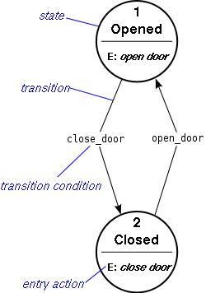
Assurance: Design and Implementation
Formal verification can be used to prove that an implementation satisfies a formal specification and other properties, such as loop-free and free of buffer overflow
Each line of code is a function that transforms the input (including the system state) into some output (including the system state)
Drawbacks of formal verification
Difficult for large programs
E.g., the state is the value of all variables. The state space is all combinations of variables.
The state also includes the state of networking protocols, the OS, the network, etc.
The specification must be correct
To some degree, formal verification seeks to check whether an implementation actually implements the specification. We need this because it is difficult to implement systems and we make mistakes translating a specification to code
But we also make mistakes translating an informal specification to a formal one
We make mistakes making the informal specification
Even if the code can be formally verified, there are many system assumptions that impact the trustworthiness. Many attacks do not attack the software, but the assumptions or the specification.

Slide 78
Assurance: Testing
Testing is an alternative to formal verification
The test must exercise all execution paths
Not always easy to achieve
Test vectors
Set of inputs and desired outputs
Fails to capture behavior caused by unforeseen inputs (e.g., a web-based interface to a database might not be tested for SQL injection attacks)
Error testing
Set of errors and desired outputs
Similar to the above, but can capture some attacks. E.g., we can test that attempted sql injection attacks are not passed to the database

Slide 79
Risk Analysis
Risk – The potential for loss, damage or destruction of an asset as a result of a threat exploiting a vulnerability.
Potential = likelihood
Loss, damage etc. = impact
Threats exist and system designers and developers must continually fix them
Which threats should be fixed first?
We need a rational strategy to prioritize our efforts
Intuition
An unlikely attack that has little impact should receive low priority
If the power grid is rapidly switched on and off, then some UPS will fail to detect the power swing and some fraction of the redundant servers will crash
If is unlikely that an attacker can make the power grid switch on and off, and there are redundant servers, so there would only be a delay in processing, which is only an issue at the peak time
A likely attack that has a significant impact should receive high priority
The company’s database has a web interface that is likely susceptible to injection attacks
Risk estimation
Open Web Application Security Project (OWASP) Risk Rating Methodology

Slide 80
Risk Analysis
Risk: two components
The probability of a successful attack
The impact of a successful attack
Risk (in theory) = the probability of a successful attack × the impact of an attack
If the impact can be quantified, such a loss in revenue, them this equation make sense.
Otherwise we make a plot, where relative impact is estimated
Risk curve
Current risk: the equi-risk curve where all threats are on the left
Goal: all threats should be removed or transformed so that the equi-risk curve is moved to the left
typical DoS
Equi-risk curve
likely
Insider attack by database admin
unlikely
Sophisticated, high powered DoS

Slide 81
Risk Analysis
Risk: two components
The probability of a successful attack
The impact of a successful attack
Risk (in theory) = the probability of a successful attack × the impact of an attack
If the impact can be quantified, such a loss in revenue, them this equation make sense.
Otherwise we make a plot, where relative impact is estimated
Risk curve
Current risk: the equi-risk curve where all threats are on the left
Goal: all threats should be removed or transformed so that the equi-risk curve is moved to the left
Risk drawbacks
Impact and probability are difficult to estimate
They can change
A vulnerability in a public or private cloud and enable an attacker to make very strong DoS
Iran is attacking US more frequently
Effort of fixing the threat is not taken into account
Risk benefits
Allows for rational discussion
Equi-risk curve
likely
Insider attack by database admin
unlikely
small impact
big impact
database admin cannot overwrite backup
database admin and backup admin coordinate attack

Slide 82
Threat vs Vulnerability vs Risk
Threat: Something I need to protect against
Someone stealing my car
Someone deleting customer payment records
Vulnerability
A weakness that allows someone to carry out a threat
E.g., getting a master key for all cars is a vulnerability
Exploit
A specific way to take advantage of a vulnerability
Risk
The likelihood and impact of a vulnerability being exploited

Slide 83
Human Issues
As software has become stronger (e.g., fewer buffer overflow attacks), human-centric attacks have become a more important attack vector
Insider attack: disgruntled employee, ambitious employee (rogue stock trader)
Poor training
Over worked
Cumbersome security mechanisms and policy
Employees circumvent mechanisms and do not follow policy
Social networking
Targeted email or even a phone call. E.g., the VP of engineering’s name is learned and the new IT person home phone is learned. The attacker calls late at night impersonating an angry VP of engineering and requesting a password change
Phishing
Organizational issues
Security brings in no income and annoys everyone
Security people are slightly more appreciated than tax collectors
No need to improve security when there is no attack
Blamed when an attack is successful, but rarely given resources six months after the attack

Slide 84
Review
CIA
C: Confidentiality
I: Integrity
A: Availability
Threat vs attack
Classes of threats
Disclosure
Deception
Disruption
Usurpation
Types of Threats
Snooping
Modification or alteration
Man-in-the-middle attack
Masquerading or spoofing
Source address spoofing
Repudiation of origin
Denial of receipt
Delay (why does this matter?)
denial of service (DoS)
Network attack amplification
prevention, detection, recovery
policy
security mechanism
Assumptions
Specification: formal vs informal
Formal verification (pros/cons)
Testing (pros/cons)
Risk analysis (what are the dimensions)
Human Issues

Slide 85
Key Points
Policy defines security, and mechanisms enforce security
Confidentiality
Integrity
Availability
Trust and knowing assumptions
Importance of assurance
The human factor

